Slide 1
Mid-Semester Project Evaluation: ECE501 Digital Image Processing
Group: 16 - Project 5
Seam Carving: A Content Aware Image Resizing Technique
Name | Roll No
Kushal Rathod | AU2340189
Deep Suthar | AU2340232
Shayan Pariyal | AU2340107
Ura Modi | AU2340031

Slide 2
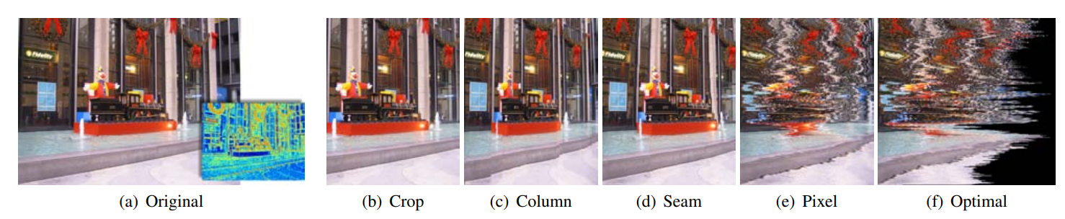
Introduction: Image Resizing
Changes Image Dimension
Traditional Methods:
Fig: 1 Methods of Resizing the Image [1]
Limitations:
Ignores content importance
Distortion of Important Region
Visual Quality Compromised
[1] Avidan, S., & Shamir, A. (2007). Seam Carving for Content-Aware Image Resizing. ACM TOG.

Slide 3



Introduction: Seam Carving
Intelligent Resizing that preserve important content
Energy map to find low important region
Remove low important seams
Maintains object and visual balance
Application: Adjusting the projection size
Fig: 2 (a) Original Image [2]
Fig: 2 (b) Horizontal seam carving
( Reducing Height by 130 pixels) [2]
Fig: 2 (c) Vertical seam carving
(Reducing Width by 100 pixels) [2]
[2] M. Alnammi, “Implementing Seam Carving for Image Resizing,” CS 766 Project Page, University of Wisconsin–Madison. [Online]. Available: https://pages.cs.wisc.edu/~moayad/cs766/index.html#fig3 . [Accessed: 12-10-2025].

Slide 4
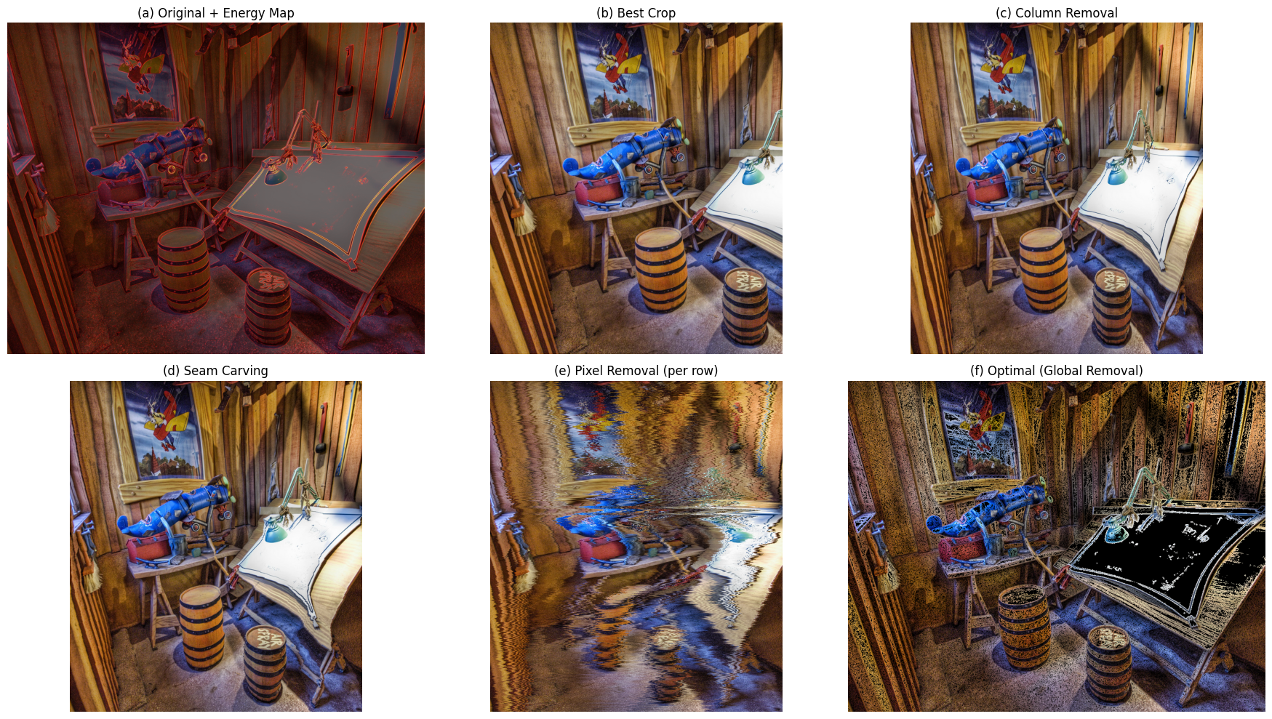
Work before Mid-Sem
Fig. 3: Output of different resizing techniques after reducing width by 30%

Slide 5
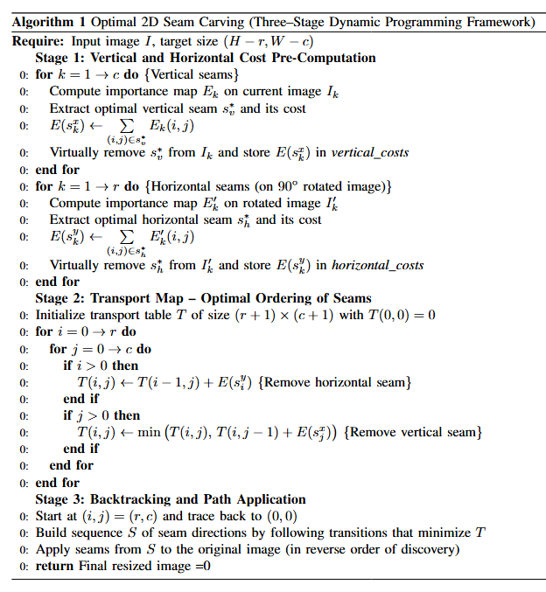
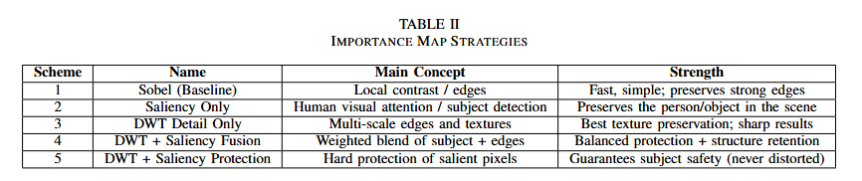
Fundamental 2D Seam Carving Algorithm

Slide 6


Updated Methodology
Scheme 1 - Sobel (Baseline)
Concept: Local contrast / edges.
Method: Convolve image / with Sobel kernels
Scheme 3 - DWT Detail only
Concept: Multi-scale textures / edges
Method: Keep all detail waveler bands
Scheme 4 - DWT + Saliency Fusion
Concept: Weighted blend of subject + details.
Method:
Scheme 2 - Saliency only
Concept: Human visual attention - protect main subject
Method: Spectral residual saliency
Scheme 5 - DWT + Saliency Protection
Concept: Guaranteed protection - subject is never distorted.
Method:

Slide 7
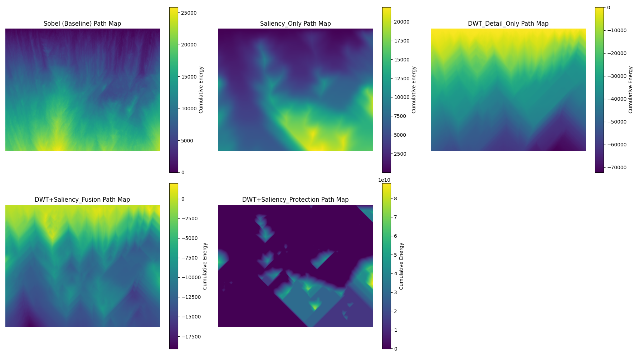
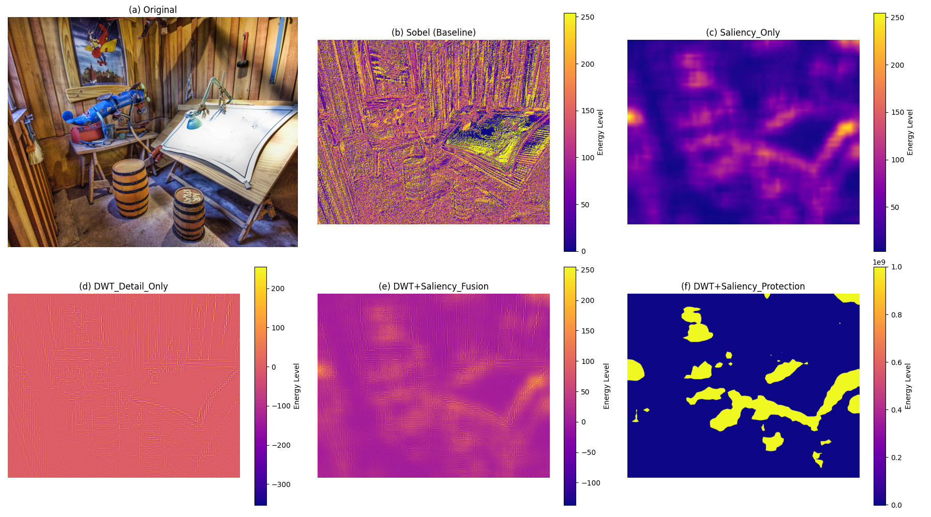
Fig. 4: Path Maps
Fig. 5: Importance Maps

Slide 8
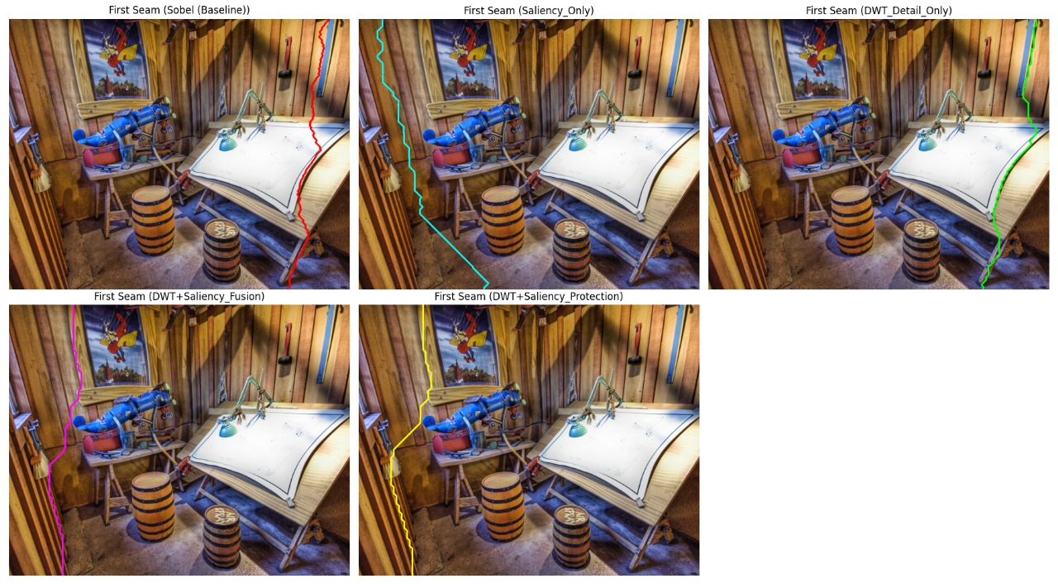
Results
Fig. 6: First Seam Identified by various resizing techniques

Slide 9
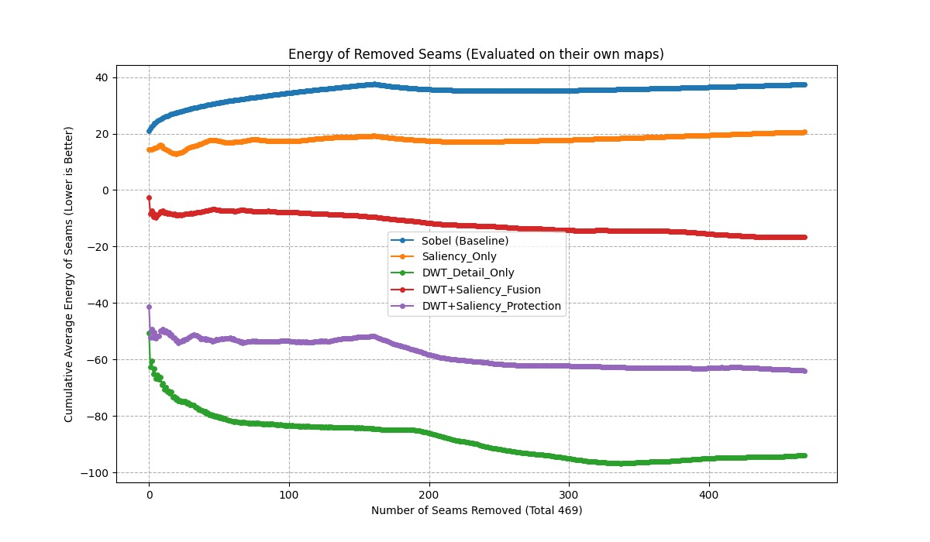
Results
Fig. 7: Average Energy of the Seams removed vs Number of Seams Removed

Slide 10
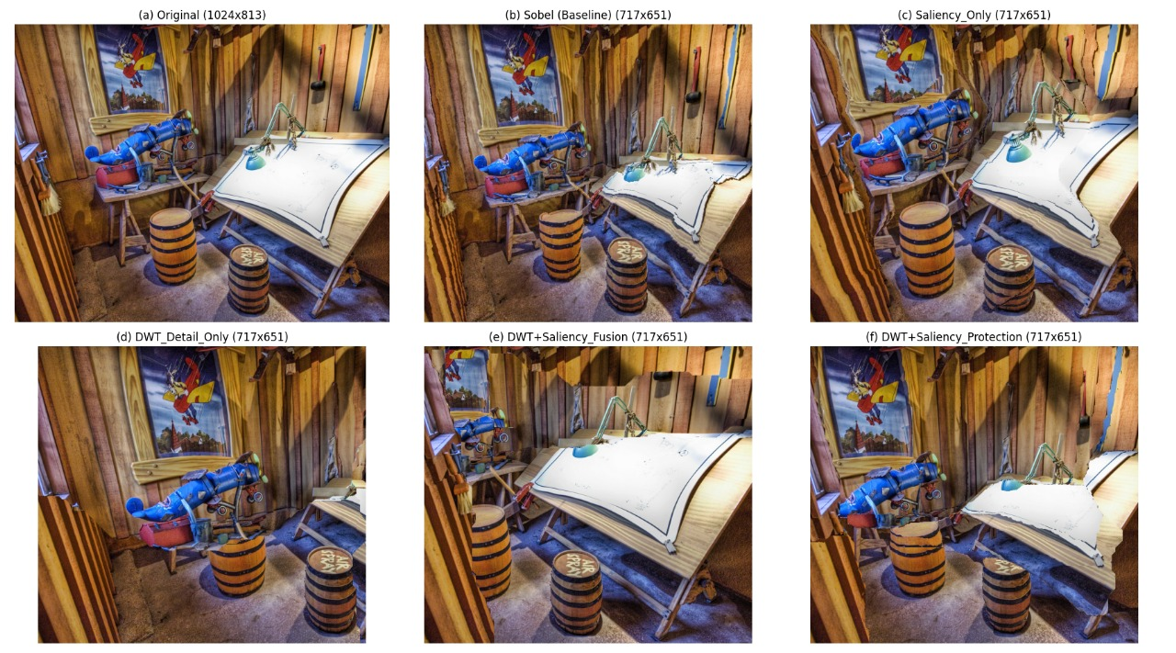
Results
Fig. 8: Final results of various resizing techniques

Slide 11
Conclusion
Introduced a spectrally-aware, multi-scale importance map for seam carving using DWT.
Summed multi-level DWT detail coefficients and reconstructed the map via IDWT to overcome scale-blindness.
Achieved improved artifact suppression, structural consistency, and semantic retention while staying fully compatible with standard seam carving.

Slide 12
References
1] S. Avidan and A. Shamir, “Seam carving for content-aware image resizing,” ACM Trans. Graph., vol. 26, no. 3, pp. 10–19, 2007. [Online]. Available: https://dl.acm.org/doi/10.1145/1276377.1276390
2] M. Alnammi, “Implementing Seam Carving for Image Resizing,” CS 766 Project Page, University of Wisconsin–Madison. [Online]. Available: https://pages.cs.wisc.edu/~moayad/cs766/index.html#fig3 . [Accessed: 12-10-2025].
3] M. Rubinstein, D. Gutierrez, O. Sorkine, and A. Shamir, “A comparative study of image retargeting,” ACM Trans. Graph., vol. 29, no. 5, pp. 160:1–160:10, 2010. [Online]. Available: https://dl.acm.org/doi/10.1145/1882261.1866186
4] Z. Alswaidan, M. H. Shullar, K. Chikhaoui, and M. Alfarraj, “Object-aware adaptive image retargeting via importance map fusion,” in Proc. 2024 IEEE International Conference on Image Processing (ICIP), Abu Dhabi, United Arab Emirates, pp. 1528–1533, 2024. [Online]. Available: https://ieeexplore.ieee.org/document/10648064

Slide 13
Thank You

